Slide 1
The Structure of Scientific Collaboration Networks
Writen by M. E. J. Newman
Presented by Chang Xu

Slide 2
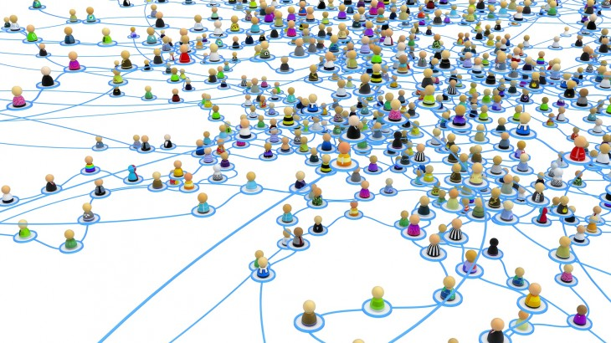
The Structure of Social Networks
How many steps you need to deliver something to a specific person that you never know before through a chain of “a friend of a friend”?
Small-world experiment
by Stanley Milgram

Slide 3
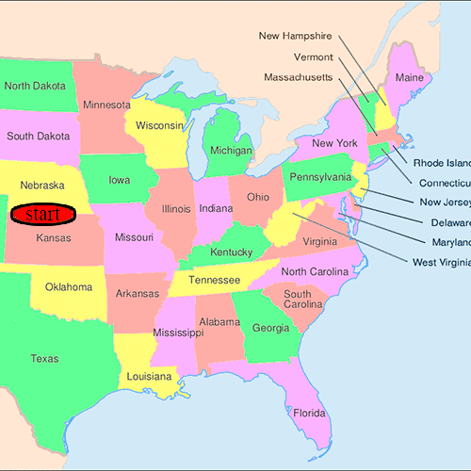
Small-world Experiment
Method:
Result:
Six degrees of Separation
Biases:
Letter get lost
Detailed structure of social networks

Slide 4
More experiments
  Friendship networks among schools/ communities
  The size of network is limited
  Sensitive to “acquaintance”
  Electric Power Grid/ the Internet/ Air Traffic
  Doesn’t directly measure actual contact between people
  Studies of the network of movie actors
  Hard to know if they are acquainted

Slide 5
Scientific Collaboration Networks
Why Scientific?
Method:
Erdős number
Acquaintance
Database
MEDLINE
Los Alamos e-Print Archieve
SPRISES
NCSTRL
Unrefereed Preprints
Paul Erdős
Definitions
Biases

Slide 6
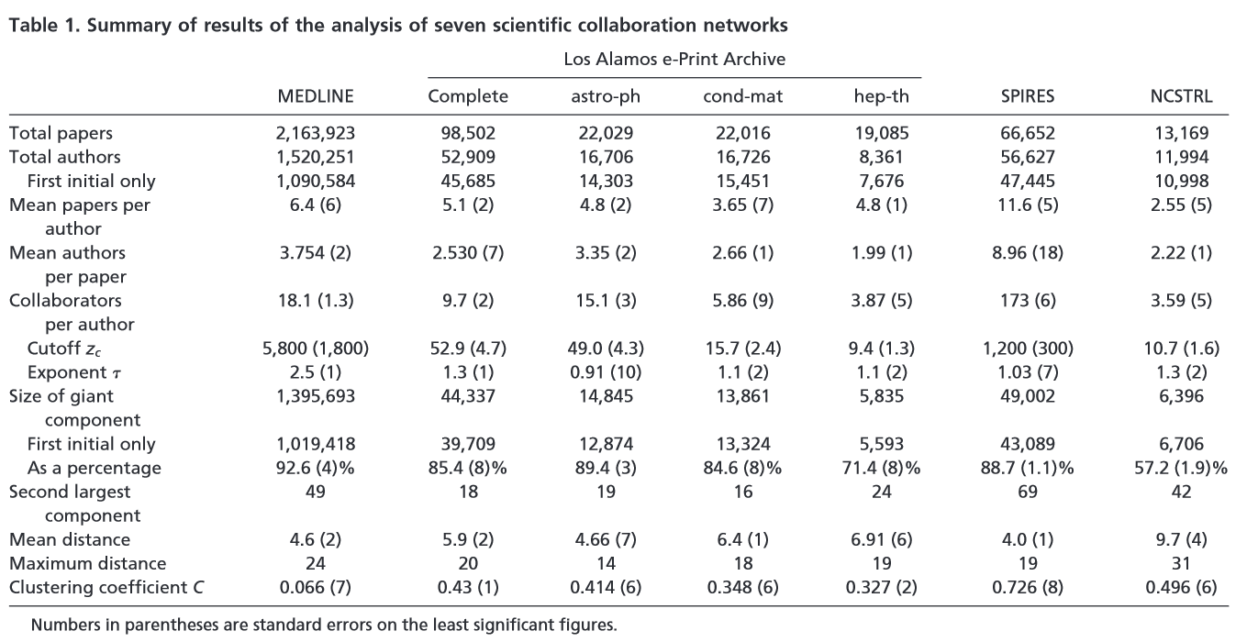
Result

Slide 7
Numbers of Authors
Problem:
  Two authors with same name
  Authors identify themselves in different ways on different papers
Solution:
  Use initials at first time Overestimate
  Use first initial of each author underestimate
  Gives upper and lower bounds

Slide 8
Mean Papers per Author
& Authors per Paper
Marked numbers
4 papers per author
3 authors per paper
9 authors per paper in the SPIRES high-energy physics database
    Contains both experimental and theoretical work
    Experimental work could run much more people
    The largest author list in the SPIRES database = 1681 authors in 1 paper

Slide 9
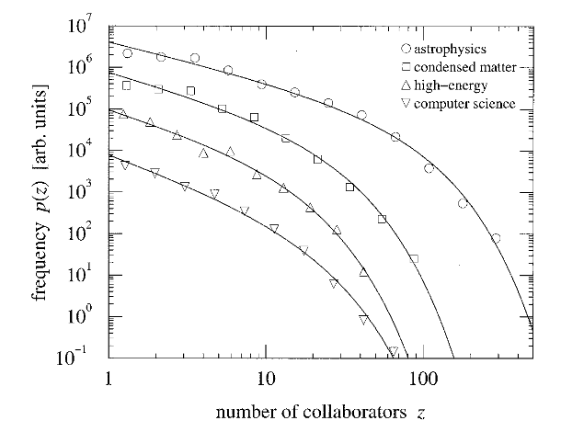
Numbers of Collaborators
Less than 4 in pure theoretical databases
The degree is high in physics and astrophysics/MEDCINE
SPIRES reaches 173
Histograms of the numbers of collaborators of scientists in database

Slide 10
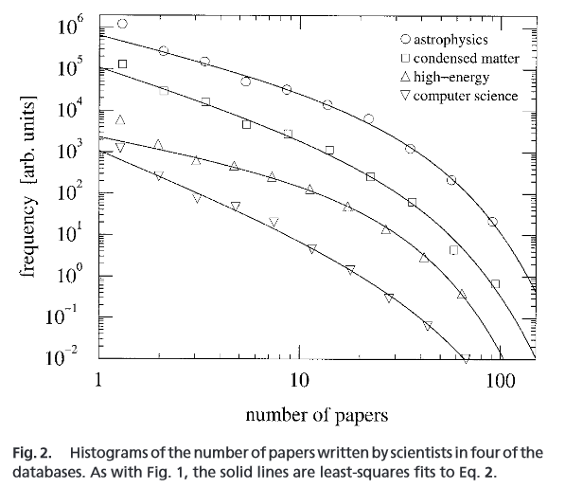

Countinued
The numbers of papers written by scientists in four of the database studies
where exponent and cutoff are constants.

Slide 11
Exponent & Cutoff analysis
Exponent
Close to 1 in “hard science”
➔Few individuals with large collaborators
2.5 in MEDICINE
  ➔ Dominated by the “little people”
Cutoff
10 in theoretical research
Much larger values in SPIRES and MEDCINE

Slide 12
The Giant Component
80% or 90% of all authors are connected by some paths of intermediate coauthors in most databases.
Smaller but still more than half in high-energy theory and Computer Science.
Considered as advantage

Slide 13
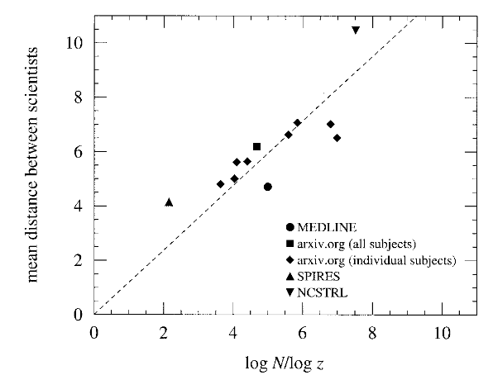
Average Degrees of Separation
Average of 6
Log N/ log z ➔ R^2 = 0.83
  (where N = numbers of scientists, z = mean number of collaborators)
Maximum separation of pairs: 20

Slide 14

Clustering
Cluster coefficient
Two scientists have a 30% or higher probability if both have collaborated with a third scientist.
Low C in MEDCINE database
      ➔Tree-like networks

Slide 15
Conclusions
Constitute a “small world”.
The distributions of both the numbers of collaborators and the numbers of papers they write are fit by power-law with an exponent cutoff.
Highly clustered.
Differences between scientific communities.

Slide 16
Thank you for watching
Chang Xu

Slide 17
Reference:
Andrew A. (n.d.). “One possible path of a message in the “Small World” experiment by Stanley Milgram” Retrieved from:
https://commons.wikimedia.org/wiki/File:Experement_Small_World_(possible_option).gif
Newman M.E.J. (July, 2000). “The structure of scientific collaboration networks” Santa Fe Institute
Saragossi J. (Nov, 2013). “Facebook is for grandparents: What we need in a next-gen social network” Retrieved from:
https://thenextweb.com/socialmedia/2013/11/24/facebook-grandparents-need-next-gen-social-network/#.tnw_YxeO9Eqr

